Slide 1
The software process
A structured set of activities required to develop a software system
  Specification
  Design
  Validation
  Evolution
A software process model is an abstract representation of a process. It presents a description of a process from some particular perspective

Slide 2
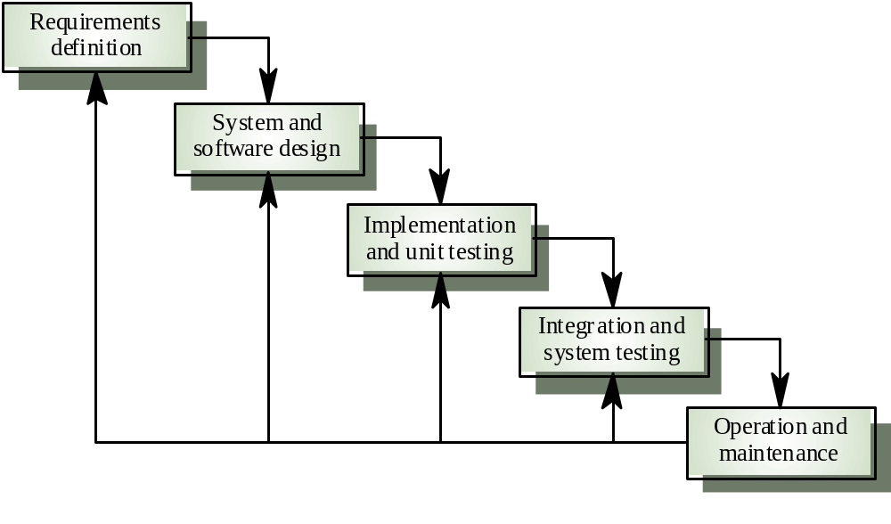
Waterfall model

Slide 3
What is Agile?
Agile is literally the ability to respond to change.
Nowadays, when consumers’ expectation changes more quickly than what business owners can predict, applying an agile methodology and incrementally figuring things out will help steer clear of serious risks.

Slide 4
What is Agile Software Development?
The agile model in software engineering is an iterative adaptive software development approach that emphasizes flexibility, collaboration, iterative development, and rapid response to change.
An Agile delivery model comprises small releases through small iterations. During each iteration, IT experts will carry out a particular amount of work and have the deliverable reviewed by stakeholders. Iterations are built upon each other, the latter outcome is better than the former, until the product reaches product-market fit.

Slide 5
Traditional vs. Agile Approach To Software Development
 | Traditional approach | Agile approach
Development life cycle | Linear | Iterative
Style of development | Anticipatory | Adaptive
Guidance | Based on traditional requirements Completely defined upfront | Based on user stories Fundamentally defined upfront and evolved during the project
Documentation | Meticulous | Compact, partially replaced by direct discussion
Management | Process centric | Collaboration centric
Client involvement | Low involvement | Frequent, active involvement
Delivery | All at once, in a big batch | Batch by batch, the latter is better than the earlier
Measure of success | Conformance to plan | Usability and product-market fit

Slide 6
AGILE PRINCIPLES
Our highest priority is to satisfy the customer through the early and continuous delivery of valuable software.
Welcome changing requirements, even late in development. Agile processes harness change for the customer’s competitive advantage.
Deliver working software frequently, from a couple of weeks to a couple of months, with a preference to the shorter timescale.

Slide 7
4. Business people and developers must work together daily throughout the project.
5.Build projects around motivated individuals. Give them the environment and support they need, and trust them to get the job done.
6. The most efficient and effective method of conveying information to and within a development team is face-to-face conversation.

Slide 8
7. Working software is the primary measure of progress.
8. Agile processes promote sustainable development. The sponsors, developers, and users should be able to maintain a constant pace indefinitely.
9.Continuous attention to technical excellence and good design enhances agility.

Slide 9
10. Simplicity–the art of maximizing the amount of work not done–is essential.
11.The best architectures, requirements, and designs emerge from self-organizing teams.
12.At regular intervals, the team reflects on how to become more effective, then tunes and adjusts its behavior accordingly.

